Slide 1
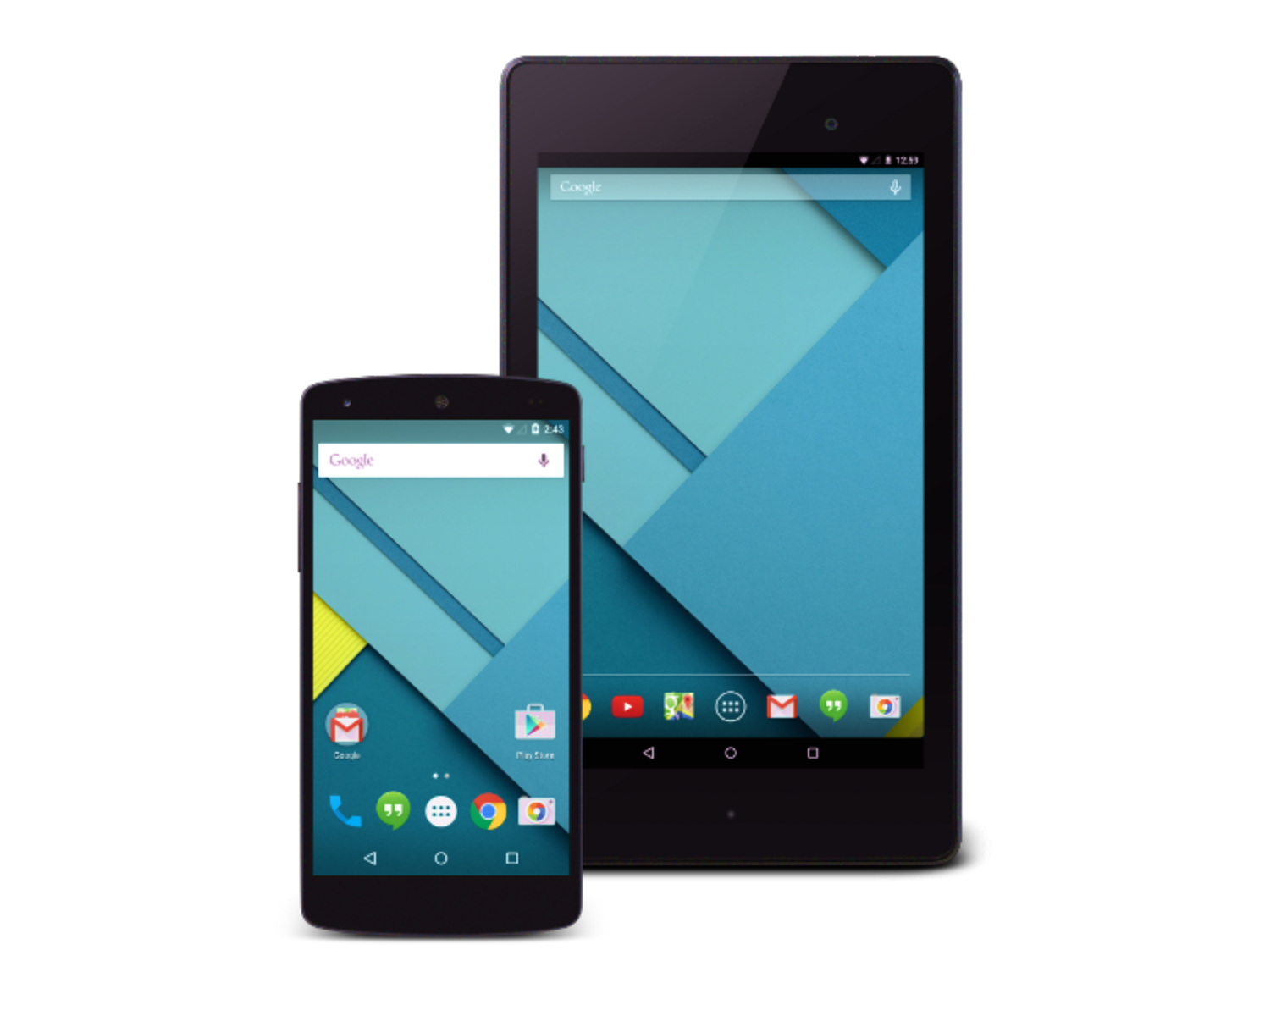

Using WebView in
Your Android Apps
+
3:15 pm – 4:30 pm, Thu July 30
AnDevCon Boston 2015
C.L. Kim
Notes:
1

Slide 2
Using the (New) WebView
Since Android 4.4 KitKat (API 19), WebView is based on the Chromium open source project
Now includes
Updated version of the V8 JavaScript engine
Support for modern web standards
Same rendering engine as Chrome for Android
https://developer.chrome.com/multidevice/android/overview

Slide 3
Using the (New) WebView …2
Since Android 5.0 Lollipop (API 21), WebView has moved to an APK
Can be updated separately from Android platform
On Nexus 4 w/Android 5.0.1: WebView (37.0.0.0)
“Android System WebView” app on Google Play
(as of June 1) version 42 available for download
Will auto-update for mobile devices with Android L and above

Slide 4
WebView: a View widget
Extends Android’s View class
JavaDocs http://developer.android.com/reference/android/webkit/WebView.html
What it is:
A View that displays web page(s)
A widget within your app’s Activity layout
Also used in cross-platform mobile development tools e.g. Apache Cordova/PhoneGap or Sencha
Hybrid apps comprising entirely a WebView do not appear to be encouraged

Slide 5
WebView... Love it or Hate it?
WebView and Hybrid Apps
“It’s definitely a complicated topic!”
Android Team
Has been heavily pushing
Improved Design Aesthetics, Platform Consistency, Smooth “Jank-Free” interaction
So, encourages developers to build native apps
There can be good use cases for WebView

Slide 6
WebView: Some use cases
Example: Enterprise mobile apps
Display a frequently revised document normally hosted on a web server
App’s workflow could include an Activity screen that contains a WebView
Display user information that is retrieved online
May be easier to build a WebView in app to show a web page with all the user data, instead of making a REST request, parsing the json response, and rendering data in an Activity screen layout

Slide 7
WebView: Some use cases …2
Example: A consumer facing app
Some or all of User Interaction on certain screens could be a WebView
“...the same code base for running the UI on all devices: tablets, phones, smart TVs, DVD players, refrigerators, and cars...”
Changing UI for A/B testing can be on the fly without app resubmission

Slide 8
Class reference material
Demo hybrid Android app references:
Demo Hybrid Mobile Organizer
Clone from https://github.com/clkim/demoHybridMyMblOrgnzr2015
Pro iOS and Android Apps for Business: with jQuery Mobile, node.js, and MongoDB (Apress) by Frank Zammetti
The web app portion of our Demo hybrid Android app is from the book’s demo app client side; we do some hacks so as to re-use the code, but give only high-level overview of code not directly related to Hybrid apps
Book's source code is here
http://www.apress.com/downloadable/download/sample/sample_id/1471/
The web app portion needs a backend server, taken from the book’s demo app server side; we run that as is, and do not delve into that code
Notes:
8

Slide 9
Class reference material …2
Demo hybrid Android app references:
karura
An open source framework for Hybrid app development on Android
For convenience, our Demo app uses calls in some classes to access the Android built-in Contacts app’s address book data. Repo on github:
https://github.com/karuradev/karura
We will not delve into this Java code at all, but will just use its API; we also only give a cursory overview of how our Android code get the contacts in the address book (not directly related to Hybrid app topic)
Importing the previous Eclipse ADT Bundle project into Android Studio, the four karura java classes used are placed in the com.karura.framework package
When Eclipse ADT Bundle IDE was used, it was easiest to import karura as its own project; then reference it as a Library in the Demo app project
(I've gleaned some good ideas from the companion book and presented them in this class, but have not adopted the book as reference.)
Notes:
9

Slide 10
Class reference material ...3
Android documentation:
Chrome WebView for Android
https://developer.chrome.com/multidevice/webview/overview
Building Web Apps in WebView
http://developer.android.com/guide/webapps/index.html
Migrating to WebView in Android 4.4
http://developer.android.com/guide/webapps/migrating.html#URLs
Debugging Web Apps. Remote Debugging on Android with Chrome.
http://developer.android.com/guide/webapps/debugging.html
https://developer.chrome.com/devtools/docs/remote-debugging
Chromium WebView Samples
https://github.com/GoogleChrome/chromium-webview-samples
WebView JavaDocs
http://developer.android.com/reference/android/webkit/WebView.html
Notes:
10

Slide 11
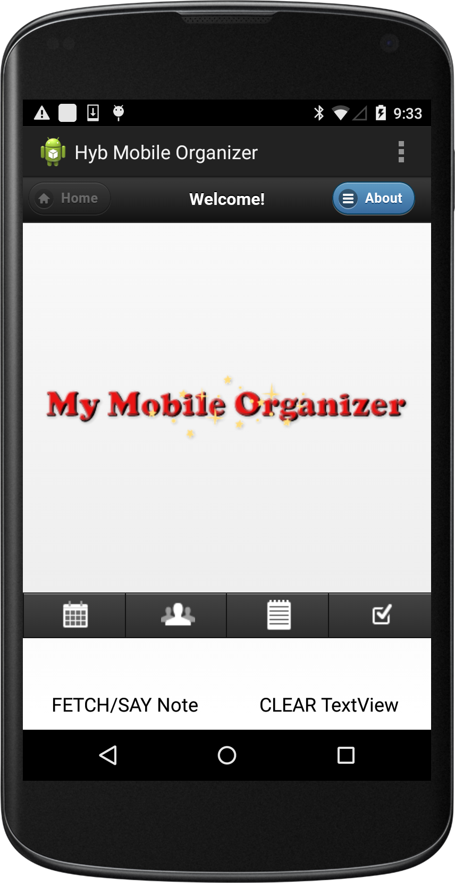
Demo Hybrid Android App
A web app client-server PIM
jQuery & jQuery Mobile
node.js & MongoDB
Demo app: Organizer
Appointments
Contacts
Notes
Tasks
Notes:
11

Slide 12
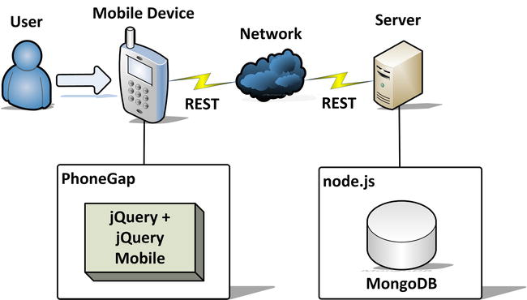
Demo Hybrid Android App ...2
Figure 1-17 of Pro iOS and Android Apps For Business
Instead of using PhoneGap to automatically wrap the web app in native code, we write our own Android app and put the web app into a WebView component within the native layout
Notes:
12

Slide 13
Demo Hybrid Android App ...3
Demo round trip calls
Android native Java code calls JavaScript
From native Button click listener, get note entries in web app with JavaScript REST call, then back in Java code use TextToSpeech to say first entry
JavaScript calls Android native Java code
From web app menu item, get all contacts in Android address book with native Java code, then back in web app use JavaScript to display newly fetched contacts
Notes:
13

Slide 14
WebView in Native App Layout
<LinearLayout xmlns:android="http://schemas.android.com/apk/res/android"
xmlns:tools="http://schemas.android.com/tools"
android:layout_width="match_parent"
android:layout_height="match_parent"
android:orientation="vertical"
tools:context="${relativePackage}.${activityClass}" >
<WebView
android:id="@+id/activity_main_webview"
android:layout_width="match_parent"
android:layout_height="0dp"
android:layout_weight="1"/>
<TextView ... />
<LinearLayout ... >
<Button ... />
<Button ... />
</LinearLayout>
</LinearLayout>
Notes:
14

Slide 15
WebView, a View widget ...2
JavaDocs http://developer.android.com/reference/android/webkit/WebView.html
Methods to load desired web page
webView.loadUrl(String url)
Request INTERNET permission in app’s Manifest file as necessary
webView.loadData(String data, String mimeType, String encoding)
Loads given data into the WebView using a ‘data://’ scheme url
JavaScript’s same origin policy prevents a script running in a page loaded using this method from accessing content loaded using any other scheme, including ‘http://’; use loadDataWithBaseURL() to avoid this restriction
e.g. webview.loadData("<html><body>You scored!</body></html>, "text/html", null);

Slide 16
WebView, a View widget ...3
JavaDocs http://developer.android.com/reference/android/webkit/WebView.html
Customization of behavior by helper classes
WebViewClient
Pertains to rendering of content
e.g. onPageFinished(WebView, String) callback
Can also intercept URL loading: ask system browser to load url instead of loading in the WebView
shouldOverrideUrlLoading(WebView, String) callback
WebChromeClient
Pertains to browser UI, e.g. reporting a JavaScript console message
onConsoleMessage(ConsoleMessage) callback

Slide 17
WebView, a View widget ...4
Customization of behavior (continued)
WebSettings
Manages settings for the WebView
e.g. Enabling JavaScript execution
setJavaScriptEnabled(boolean) setter
Injecting Java objects into the WebView
WebView.addJavascriptInterface(Object javaObject, String name)

Slide 18
WebView FAQ
Will the new WebView auto-update?
Yes, WebView will auto-update for mobile devices with Android 5.0 Lollipop and above
Use the beta channel for the WebView to test the latest beta version in your app before that version rolls out to your users
See this Android Developer blog post
http://android-developers.blogspot.com/2015/02/beta-channel-for-android-webview.html

Slide 19
WebView FAQ …2
Does the new WebView have feature parity with Chrome for Android?
For the most part, features that work in Chrome for Android should work in the new WebView
See Chrome for Android – Overview page
https://developer.chrome.com/multidevice/android/overview
Chrome for Android supports a few features which aren’t enabled in the WebView, including
Fullscreen API
Filesystem API and File input type (Chrome specific/only)
https://developer.chrome.com/multidevice/webview/overview

Slide 20
WebView FAQ …3
What hardware sensor HTML5 APIs are available to the new WebView?
Geolocation API (as of WebView v33)
Vibration API (as of WebView v33)
Does WebView support Chrome Apps APIs?
The Chrome Apps platform is not yet supported on Android (as far as I know)

Slide 21
Hybrid Android App Basics
Android Studio’s app/build.gradle
android {
compileSdkVersion 21
buildToolsVersion ”21.1.1"
defaultConfig {
applicationId "com.example.demohybridmymblorgnzr"
minSdkVersion 21
targetSdkVersion 21
}
...
Set minSdkVersion to API 19 and above if intend to support only the Chromium-based WebView
Notes:
21

Slide 22
Hybrid Android App Basics ...1b
AndroidManifest.xml
<manifest xmlns:android="http://schemas.android.com/apk/res/android"
package="com.example.hybriddemomymblorgnzr"
... >
<uses-sdk
android:minSdkVersion="21"
android:targetSdkVersion="21" />
...
</manifest>
The minSdkVersion value in AndroidManifest file is overriden by app/build.gradle
https://developer.android.com/tools/building/configuring-gradle.html
Notes:
22

Slide 23
Hybrid Android App Basics ...2
WebView in activity_main.xml
<LinearLayout xmlns:android="http://schemas.android.com/apk/res/android"
xmlns:tools="http://schemas.android.com/tools"
android:layout_width="match_parent"
android:layout_height="match_parent"
android:orientation="vertical"
tools:context="${relativePackage}.${activityClass}" >
<WebView
android:id="@+id/activity_main_webview"
android:layout_width="match_parent"
android:layout_height="0dp"
android:layout_weight="1"/>
...
...
</LinearLayout>
Notes:
23

Slide 24
Hybrid Android App Basics ...3
WebView in MainActivity.java
public class MainActivity extends Activity { ...
private Context mContext;
private WebView mWebView;
...
@Override
protected void onCreate(Bundle savedInstanceState) {
super.onCreate(savedInstanceState);
setContentView(R.layout.activity_main);
mContext = this;
...
mWebView = (WebView) findViewById(R.id.activity_main_webview);
...
}
Notes:
24

Slide 25
Hybrid Android App Basics ...4
Enable JavaScript in the WebView
public class MainActivity extends Activity { ...
private WebView mWebView;
...
@Override
protected void onCreate(Bundle savedInstanceState) {
...
// Enable Javascript
WebSettings webSettings = mWebView.getSettings();
webSettings.setJavaScriptEnabled(true); ...
}
WebView does not allow JavaScript by default
Notes:
25

Slide 26
Hybrid Android App Basics ..9a
Loading HTML files from the file system
Store web files (html, js, css) in assets folder
Android reserves that directory for raw files that it knows it should minimize or compress
Good practice to keep web files in their own subdirectory, so create an assets/www subfolder
Absolute paths do not work in the WebView
Refer to other web files with relative references
E.g. <a href="./contactPage.html"...> or <a href="contactPage.html"...>
Not <a href="/contactPage.html"...>

Slide 27
Hybrid Android App Basics ..9b Loading the web app 'home' page
public class MainActivity extends Activity { ...
private static final String FILE_URL_INDEX_HTML =
"file:///android_asset/www/index.html"; ...
private WebView mWebView;
...
@Override
protected void onCreate(Bundle savedInstanceState) {
...
// webview methods must be called on UI thread; and non-blocking
mWebView.loadUrl(FILE_URL_INDEX_HTML); ...
}
A simple loadUrl(String url) starts the web app!
WebView methods must be called on UI thread
So such methods must be non-blocking

Slide 28
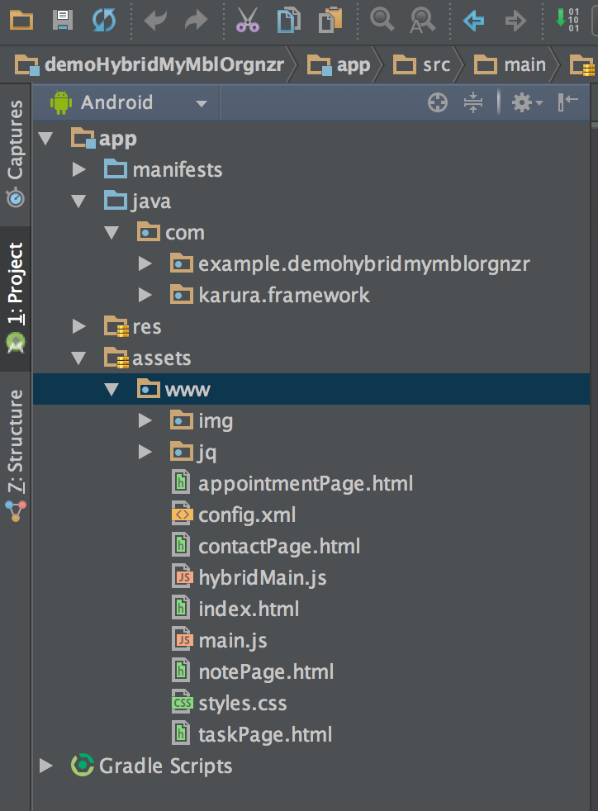
Hybrid Android App Basics ..9c The web app files
In assets/www
Home page: index.html
JavaScript code: main.js
CSS: styles.css
Contacts: contactPage.html
Notes: notePage.html

Slide 29
Building demo Hybrid App in WebView Binding JavaScript to Android
JavaScript in WebView calling a method in Android Java code to fetchContacts()
Create a javascript-java-interface class
public class MainActivity extends Activity {
...
public class MyJsToJavaInterfaceObject {
/** Fetch contacts from native address book */
@JavascriptInterface //mandatory if targetSdkVersion 17+ & running Android 4.2+
public void fetchContacts(final String handleIdForDeferredObject) {
// code to do fetch contacts in the “Contacts” app address book...
}
}...
}

Slide 30
Building demo Hybrid App in WebView Binding JavaScript to Android ...2
Call addJavascriptInterface() on the webview
public class MainActivity extends Activity { ...
private static final String JS_INTERFACE_OBJECT_NAME = "MyAndroid";
...
@Override
protected void onCreate(Bundle savedInstanceState) {
...
// inject a javascript-java-interface object, available to JavaScript at next page (re)load
mWebView.addJavascriptInterface(new MyJsToJavaInterfaceObject(),
JS_INTERFACE_OBJECT_NAME);
...
}...
}

Slide 31
Building demo Hybrid App in WebView Binding JavaScript to Android ...3
In webview Javascript, use the javascript-java-interface object named MyAndroid to call the Android fetchContacts(String) method
contactPage.html
<!-- Menu. -->
<div data-role="popup" id="contactMenu">
<ul data-role="listview" data-inset="true" ...>
...
<li>
<a href="javascript:doFetchContacts('contact');">Fetch Contacts</a>
</li>
</ul>
</div>

Slide 32
Building demo Hybrid App in WebView Binding JavaScript to Android ...4
main.js
function doFetchContacts(inType) {
fetchContacts()...
...
}
...
function fetchContacts() {
...
// initiate native Android request to fetch contacts, and
// pass the deferred object handleId for that async
// process to call resolve() or reject()
MyAndroid.fetchContacts(currentHandleId);
...
}

Slide 33
Building demo Hybrid App in WebView Binding JavaScript to Android ...5
Some gotchas
must add the @JavascriptInterface annotation to any method that you want available to your JavaScript (the method must also be public)
If not, the method is not accessible by web page for app on Android 4.2+ (target sdk API 17+)
The “MyAndroid” object bound to JavaScript runs in another thread, and not in the thread in which it was constructed

Slide 34
Building demo Hybrid App in WebView Binding JavaScript to Android ...6
Caution: Using addJavascriptInterface() on a WebView allows JavaScript to control your Android application
should not use addJavascriptInterface() unless you wrote all of the HTML and JavaScript that appears in your WebView
should also not allow the user to navigate to other web pages (displayed within your WebView) that are not your own; instead, allow the device's default mobile browser application to open foreign links, by overriding shouldOverrideUrlLoading()
method of a WebViewClient object set on WebView object

Slide 35
WebView in Android 4.4 Multi-threading consideration
Don’t call methods on WebView from any non-UI thread
Can cause unexpected results
Example: if app uses a worker thread

Slide 36
WebView in Android 4.4 Multi-threading consideration ...2
To ensure code runs on the UI thread,
use: runOnUiThread() from the non-UI thread
runOnUiThread(new Runnable() {
@Override
public void run() {
// Code calling WebView method(s) goes here
}
});
E.g. See later, method: getContactsAndResolveJSDeferredObj(..)
Is run in a worker thread to get contacts in ‘Contacts’ app, then runs JavaScript code using a WebView method which must be run on the UI thread

Slide 37
WebView in Android 4.4 UI Thread Blocking
Never block the UI thread
// Example: app is waiting for a JavaScript callback
// This code is BAD -- blocks the UI thread
webView.loadUrl("javascript:myfn()");
while(result == null) Thread.sleep(100);
To run JavaScript asynchronously in WebView, use: evaluateJavascript()
Introduced in API Level 19, Android 4.4 (KitKat): a Chromium WebView method

Slide 38
WebView.evaluateJavascript()
public void evaluateJavascript (
String script, ValueCallback<String> resultCallback)
Asynchronously evaluates JavaScript in context of the currently displayed (webview) page
Parameters: a String script, a ValueCallback<String> callback function that takes a String result
resultCallback, if non-null, will be invoked with the result received from the JavaScript script execution (if any)
Override the onReceiveValue(String) method of ValueCallback
Method must be called on the UI thread
Because it is a WebView method
Callback will be made on the UI thread

Slide 39
Demo Hybrid Android App Java-JavaScript-Java
Demo round trip calls
Android native Java code calls JavaScript
From native Button click listener, get all note entries in web app with JavaScript REST call, then back in Java code, get first entry and use TextToSpeech to say item
In onCreate() check whether TextToSpeech data for the language is installed/present
Click listener runs a method in which WebView calls evaluateJavascript() to get the note entries asynchronously
In the async callback, native TTS engine says first entry item

Slide 40
Demo Hybrid Android App Java-JavaScript-Java ...2
Check can handle TTS – overview only
public class MainActivity extends Activity { ...
private TextToSpeech mTextToSpeech; ...
protected void onCreate(Bundle savedInstanceState) { ...
// check there is data for language installed, for TTS
Intent checkTtsIntent = new Intent();
checkTtsIntent.setAction(TextToSpeech.Engine.ACTION_CHECK_TTS_DATA);
startActivityForResult(checkTtsIntent, MY_REQUEST_CODE);
...}
@Override
protected void onActivityResult(int requestCode, int resultCode, Intent intent) {
if (requestCode == MY_REQUEST_CODE) {
if (resultCode == TextToSpeech.Engine.CHECK_VOICE_DATA_PASS) {
// success, create the TTS instance
mTextToSpeech = new TextToSpeech(getApplicationContext(),
new TextToSpeech.OnInitListener(){ ... }); ...
...}

Slide 41
Demo Hybrid Android App Java-JavaScript-Java ...3
Button listener
public class MainActivity extends Activity { ...
private Button mButtonFetchSay;
private Button mButtonClear; ...
@Override
protected void onCreate(Bundle savedInstanceState) {
...
mButtonFetchSay = (Button) findViewById(R.id.activity_main_button_fetch);
mButtonFetchSay.setOnClickListener(new View.OnClickListener() {
@Override
public void onClick(View v) {
fetchAndSayFirstNoteEntryInWebApp();
}
});
mButtonClear = (Button) findViewById(R.id.activity_main_button_clear); ...
} ...
}

Slide 42
Demo Hybrid Android App Java-JavaScript-Java ...4
Build JavaScript statements as a String
public class MainActivity extends Activity {
...
private void fetchAndSayFirstNoteEntryInWebApp() {
String jsStatements =
// ajaxURLPrefix is http://127.0.0.1:8080, path is /note
// ajax call should wait for response, then fire off ValueCallback with result
"var jqXHR = $.ajax({ url: ajaxURLPrefix+'/note', async: false }); " + "var resp = jqXHR.responseText; " +
// response is json text, not xml
// convert response to a JavaScript object as the result value to be received
"JSON.parse(resp); ";
String js = String.format("javascript:%s", jsStatements);
<... continue ...>
}
...
}

Slide 43
Demo Hybrid Android App Java-JavaScript-Java ...5
Call evaluateJavascript()
private void fetchAndSayFirstNoteEntryInWebApp() {
<... continued ...>
mWebView.evaluateJavascript(js, new ValueCallback<String>() {
@Override public void onReceiveValue(String s) {
String text;
try { // web app stores notes as array of json notation object literals
JSONArray allNotes = new JSONArray(s);
JSONObject firstNote = (JSONObject) allNotes.get(0);
// property name for note body is “text”
text = firstNote.getString("text");
} catch (JSONException e) { text = ""; }
mTextToSpeech.speak(text, TextToSpeech.QUEUE_ADD, null, null);
...
mTextView.setText(text); ...
}
}); ...
}

Slide 44
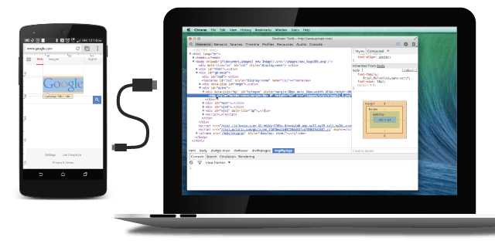
Debugging WebView Remote Debugging
If testing Android device running Android 4.4+
Can do remote debugging with: Chrome DevTools

Slide 45
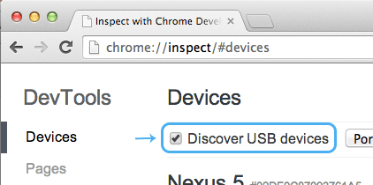
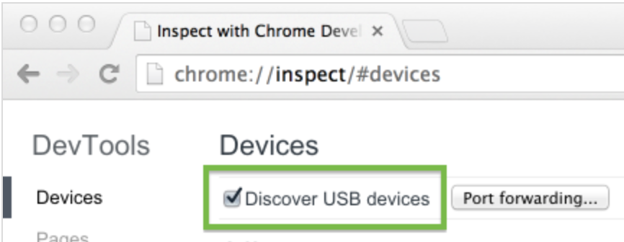
Debugging WebView Remote Debugging ...2
https://developer.chrome.com/devtools/docs/remote-debugging
Enable “USB debugging” e.g. on Android 4.2+ device
Settings > About phone > tap “Build Number” 7 times (!!)
Install Chrome 32+ on development host machine
Host’s Chrome version must > device’s Chrome for Android ver.
Enable USB discovery in Chrome on dev host machine
Check “Discover USB devices” checkbox at chrome://inspect

Slide 46
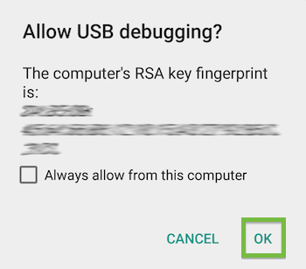
Debugging WebView Remote Debugging ...3
Connect Android device via USB cable to dev host machine
On Windows machine, require appropriate USB driver
See alert to “Allow USB debugging?”
Check “Always allow from this computer”. Tap “OK”.
[Needed by Demo Hybrid Android app only]
On Android device, run Chrome for Android (v36+) browser
Used for port forwarding

Slide 47
Debugging WebView Remote Debugging ...4a
In dev machine browser, at chrome://inspect, see:
Every connected mobile device, along with its
Mobile browser open tabs, and
Debug-enabled WebViews

Slide 48
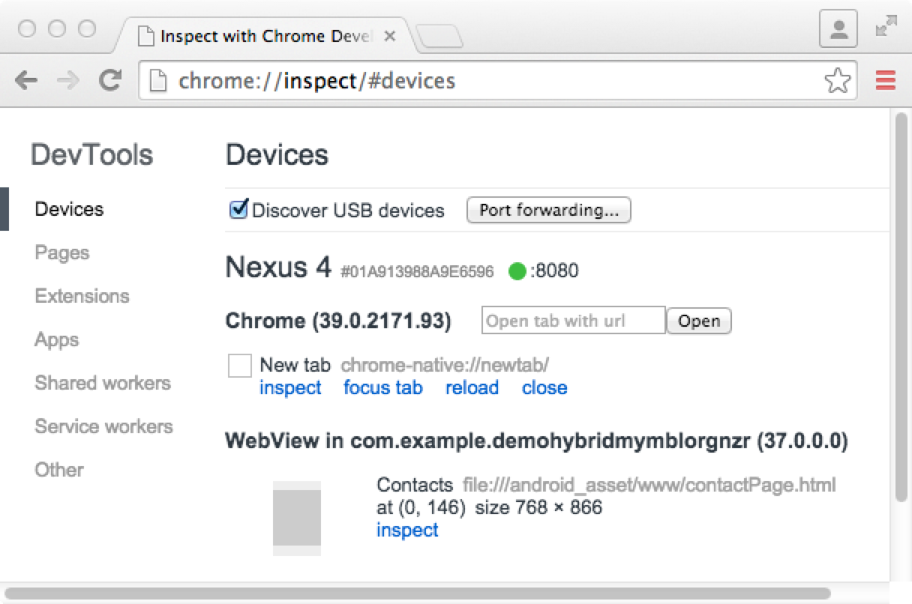
Debugging WebView Remote Debugging ...4b
Dev host
machine

Slide 49
Debugging WebView Remote Debugging …5a
Configure WebView for debugging
Need to enable it programmatically within app
Call WebView.setWebContentsDebuggingEnabled(true)
Applies to all of the app’s WebViews
Note: not affected by debuggable flag in application’s manifest
So if want to enable WebView debugging only when debuggable is true, test flag at runtime

Slide 50
Debugging WebView Remote Debugging …5b
MainActivity.java
public class MainActivity extends Activity {
...
protected void onCreate(Bundle savedInstanceState) {
...
// Configure WebView for debugging
if (Build.VERSION.SDK_INT >= Build.VERSION_CODES.KITKAT) {
if ( 0 != (getApplicationInfo().flags &= ApplicationInfo.FLAG_DEBUGGABLE) ) {
WebView.setWebContentsDebuggingEnabled(true);
}
} ...
}...
}

Slide 51
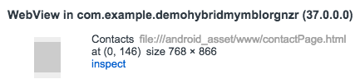
Debugging WebView Remote Debugging ...6
Run app on Android device if already installed
Or load app from Android Studio: Run > Run ‘app’ or Run > Debug ‘app’ if breakpoint doesn’t work
In dev machine Chrome browser, click “inspect” link below the WebView to open DevTools on it

Slide 52
Debugging WebView Remote Debugging + Live Screencasting ...7
Live screencast
Displays mobile device’s screen right alongside DevTools on the development machine
Can also interact with content on mobile device from the screencast
Available for Android WebViews (and mobile browser tabs) as of KitKat 4.4.3

Slide 53
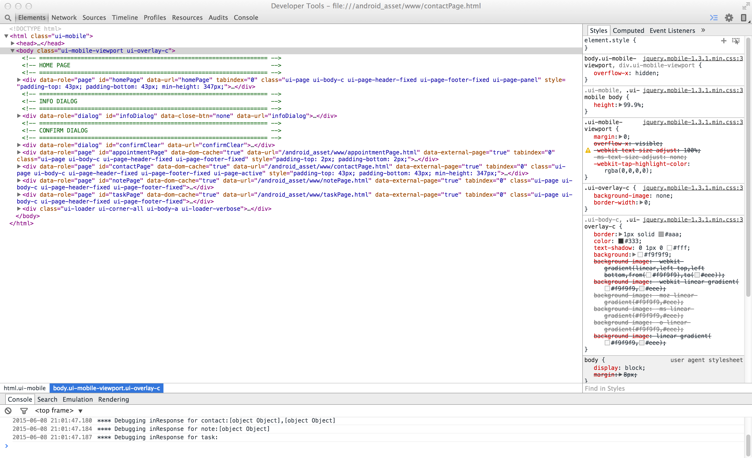
Debugging WebView Remote Debugging ...8
Screencast
Elements

Slide 54
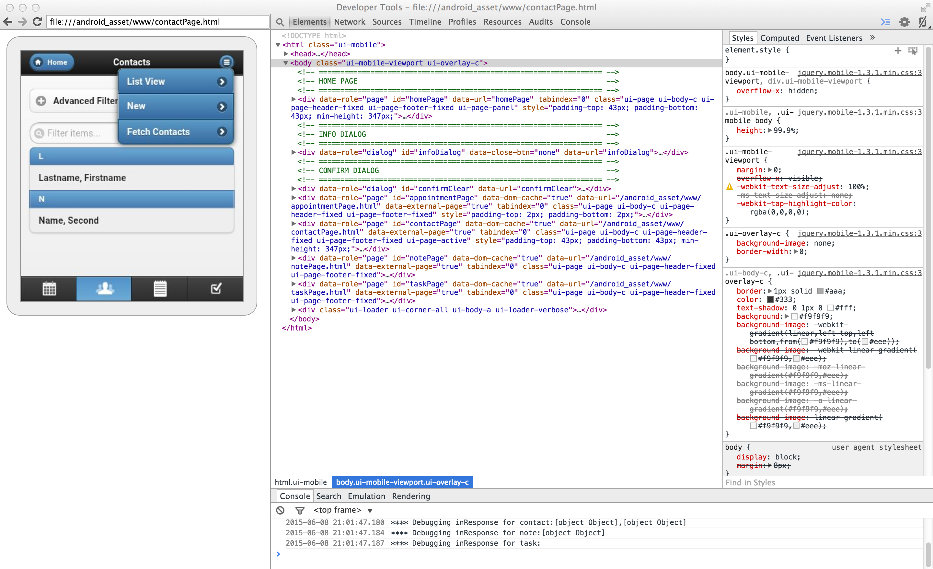
Debugging WebView Live Screencasting …9
Screencast
Interactive e.g.
Click to tap
Scroll by mousewheel or trackpad

Slide 55
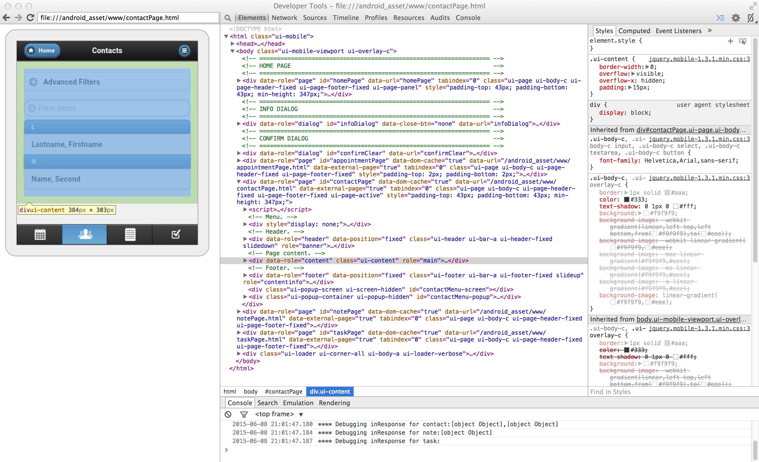
Debugging WebView Remote Debugging …10
Mousing over an element

Slide 56
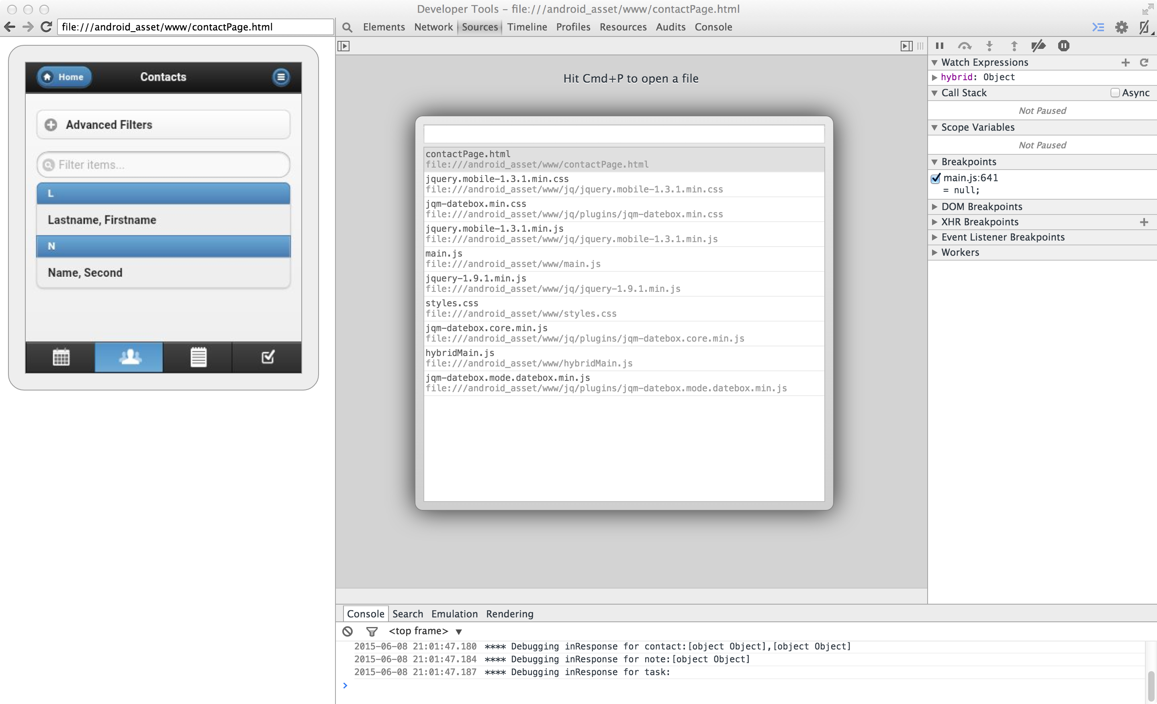
Debugging WebView Remote Debugging …11
Sources

Slide 57
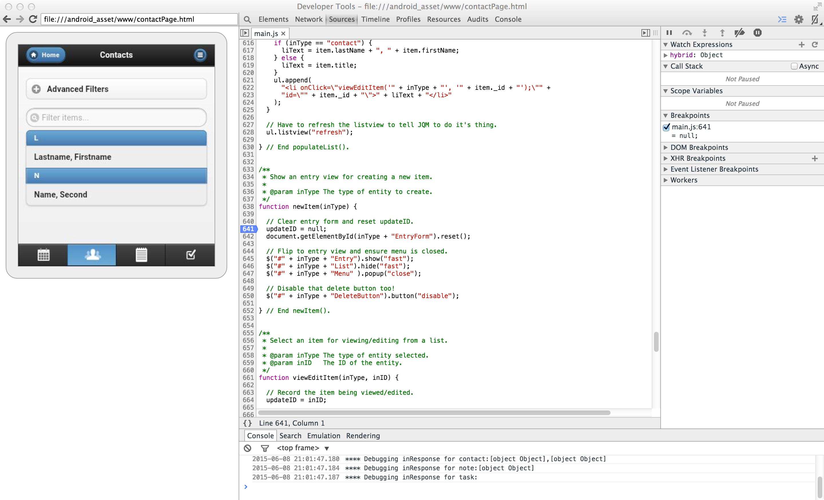
Debugging WebView Remote Debugging …12
main.js
Set break point then run code.
Here, do UI action that will run the code in function newItem(inType); code stops at break point set on line 641.

Slide 58
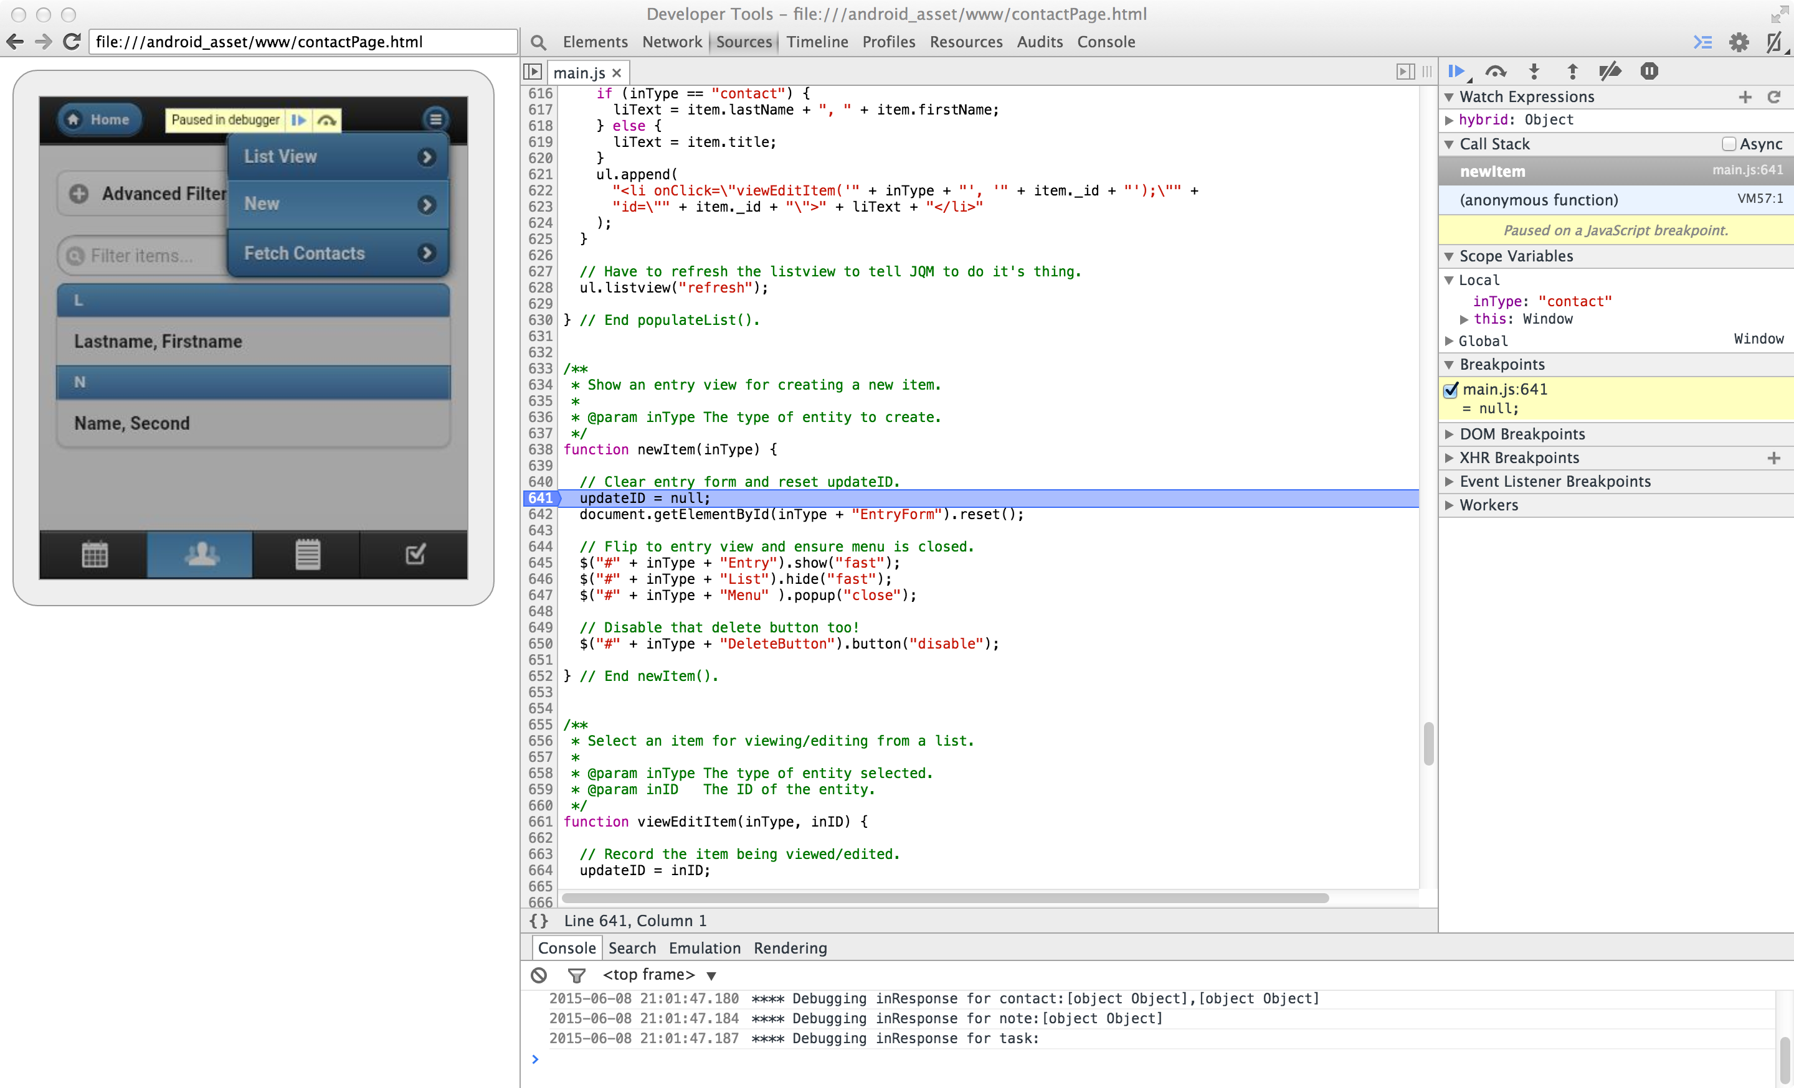
Debugging WebView Remote Debugging …13
Breakpoint reached, can step through code, see variables

Slide 59
Thread Safety
Accessing Java objects from JavaScript
Thread safety
JavaScript accesses Java, through object bound to JavaScript, in separate thread than the [UI*] thread in which that object was constructed [*in our Demo app]
http://developer.android.com/guide/webapps/webview.html
Reference: the Note near end of “Binding JavaScript code to Android code” section
Consider thread safety when accessing/mutating Java objects from JavaScript
Code in Demo app is example only; no mutation, so, unnecessary…
One approach – use a Handler, to queue/dispatch calls
E.g. WebView thread and UI thread mutating same object
Notes:
59

Slide 60
Thread Safety
Accessing Java objs from JavaScript …2
http://developer.android.com/reference/android/os/Handler.html
Handler
Sends and processes Message and Runnable objects associated with a thread's MessageQueue
A Looper is used to run the message loop
boolean Handler.post(Runnable r)
Causes the Runnable to be added to the message queue. The Runnable is run on the thread the handler is attached, e.g. the UI thread, or a worker thread
Notes:
60

Slide 61
Thread Safety
Accessing Java objs from JavaScript …3
http://developer.android.com/reference/android/os/HandlerThread.html
HandlerThread
A convenient class for starting a new (worker) thread that already has a Looper
Looper can then be used to create a Handler
Notes:
61

Slide 62
Thread Safety
Accessing Java objs from JavaScript …4
Handler constructed from HandlerThread’s Looper
code in onCreate(Bundle) callback as part of setup when starting Activity
…
workerHandlerThread = new HandlerThread("Worker HandlerThread");
workerHandlerThread.start(); …
code in fetchContacts(String) method called from JavaScript in WebView
handler = new Handler(workerHandlerThread.getLooper());
handler.post(new Runnable() {public void run() { getContactsAndResolveJSDeferredObj(...); } });
another thread can use handler.post() to access/mutate the same Java objects being accessed/mutated by JavaScript in the WebView
Notes:
62

Slide 63
Deferred Object in jQuery
Seen -- Java calling JavaScript methods
WebView's evaluateJavascript() method allows a Java callback that will be invoked asynchronously with result of the JavaScript execution
Now -- JavaScript calling Java code
How to ensure proper return back to JavaScript
Returning the result
Any error handling
One way: jQuery’s Deferred object framework
Notes:
63

Slide 64
Deferred Object in jQuery …2
Create a Deferred object
var deferred = $.Deferred();
Return a Deferred object’s Promise object
return deferred.promise();
Use returned Promise object to register callbacks:
done
fail
deferred.promise()
.then(myDoneCallback, myFailCallback);

Slide 65
Deferred Object in jQuery …3
At this point, deferred object is in pending state.
It transitions into resolved or rejected state with the corresponding calls:
deferred.resolve(arg); or deferred.reject(arg);
It then immediately executes any respective callbacks previously registered
myDoneCallback(arg); or myFailCallback(arg);

Slide 66
Demo Hybrid Android App
JavaScript-Java-JavaScript
Demo round trip calls
JavaScript calls Android native Java code
From web app menu item, get all contacts in Android address book with native Java code, then back in web app use JavaScript to display newly fetched contacts
Notes:
66

Slide 67
Demo Hybrid Android App JavaScript-Java-JavaScript ...2a
[Recap] contactPage.html
<!-- Menu. -->
... <li>
<a href="javascript:doFetchContacts('contact');">Fetch Contacts</a>
</li> ...
[Recap] main.js
function doFetchContacts(inType) {
fetchContacts()
.then(donecallback, failcallback);
}
function fetchContacts() {
... code to get a Deferred object ...
MyAndroid.fetchContacts(currentHandleId);
... code to return the Deferred object’s Promise object ...
}

Slide 68
Demo Hybrid Android App JavaScript-Java-JavaScript …2b
In the JavaScript fetchContacts() function that calls the Android code
Return a Deferred object’s Promise object with which to register the done and fail callback functions
But, how do we get back the Deferred object later – why is it needed later…?

Slide 69
Demo Hybrid Android App JavaScript-Java-JavaScript …2c
After the Android code does its Java task
Need to execute in JavaScript code the done callback if Java task is successfully done, or the fail callback if Java task fails
Can use a ‘handle id’ to access the needed (JQuery) Deferred object that has registered the callbacks
Use that Deferred object to call
resolve() if Java task is successfully done, or
reject() if Java task fails

Slide 70
Demo Hybrid Android App JavaScript-Java-JavaScript …2d
Can use a JavaScript global map variable to store the Deferred object with a ‘handle id’ key
Be careful to avoid memory leak after use by deleting reference to Deferred object
Consider not polluting the global scope, e.g. using the “hybrid” namespace for the global map variable

Slide 71
Demo Hybrid Android App JavaScript-Java-JavaScript …3
main.js
var hybrid = hybrid || {};
(function (ns) { // Immediately-Invoked Function Expression pattern
ns.currentHandleId = -1;
ns.deferredMap = {};
})(hybrid); // 'hybrid' namespace

Slide 72
Demo Hybrid Android App JavaScript-Java-JavaScript …4
main.js
function fetchContacts() {
// get a jq Deferred Object
var deferred = $.Deferred();
var hybrid = window.hybrid;
hybrid.currentHandleId += 1; // get next handleId
var currentHandleId = hybrid.currentHandleId;
// store in a Map for Deferred Objects
hybrid.deferredMap[currentHandleId] = deferred;
// initiate native Android request to fetch contacts, pass the deferred object handleId for that async process to call resolve() or reject()
MyAndroid.fetchContacts(currentHandleId);
// return the Deferred's Promise object so caller can set callbacks
return deferred.promise();
}

Slide 73
Demo Hybrid Android App JavaScript-Java-JavaScript …5a
[recap] contactPage.html
<!-- Menu. -->
... <li>
<a href="javascript:doFetchContacts('contact');">Fetch Contacts</a>
</li> ...
[recap] main.js
function doFetchContacts(inType) {
fetchContacts()
.then(donecallback, failcallback);
}
function fetchContacts() {
...
MyAndroid.fetchContacts(currentHandleId);
return deferred.promise();
}

Slide 74
Demo Hybrid Android App JavaScript-Java-JavaScript …5b
main.js
function doFetchContacts(inType) {
fetchContacts()
.then(function(jsonArray) {
for (var i=0; i<jsonArray.length; i++) {
var data = getContactAsFormData(jsonArray[i]);
// send to server
doSave2(inType, data, false);
}
}, function(errMsg) {
$("#infoDialogHeader").html("Error");
$("#infoDialogContent").html("Snap! "+errMsg+" Stopping.”);
$.mobile.changePage($("#infoDialog"), { role : "dialog" });
return;
});
}

Slide 75
M Preview - WebView
WebView
Developer Documentation download at https://developer.android.com/preview/download.html
Google I/O “What’s New In Android”: Chet Haase, Dan Sandler
postMessageToMainFrame(WebMessage, Uri)
Post a HTML5 PostMessage event to the main frame. The embedded app can restrict the messages to a certain target by specifying the origin (as a Uri) of the page that is intended to receive the message
WebViewClient.onPageCommitVisible(WebView, String)
This callback can be used to determine the point at which it is safe to make a recycled WebView visible, ensuring that no stale content is shown
WebSettings.setOffscreenPreRaster()
Sets whether this WebView should raster tiles when it is offscreen but attached to a window

Slide 76
M Preview - Chrome Custom Tabs
Current choices when user taps a URL
Launch the device browser
Context switching for user
UI not customizable
Use WebView to get an in-app ‘browser’
Does not share state with actual device browser
Extra work to get own in-app ‘browser’
Chrome custom tabs
More seamless transition between native and web
Can customize Chrome’s look and feel
Can pre-start Chome and pre-fetch content for faster loading
Reference https://developer.chrome.com/multidevice/android/customtabs

Slide 77
M Preview - Chrome Custom Tabs vs WebView
Using example of Pinterest, Chrome custom tabs allow you to load a Chrome tab (page) with pre-fetched content on top of your app
can customize experience e.g. same toolbar color, back button and overflow button at top, transition animations
provide all of Chrome’s benefits e.g. logged in session, autofill, saved password
When to use
The WebView is good solution if you are hosting your own content inside your app
If your app directs people to URLs outside your domain, recommend Chrome custom tabs

Slide 78

eventmobi.com/adcboston
Please take a moment to fill out the class feedback form via the app. Paper feedback forms are also available in the back of the room.

